Slide 1
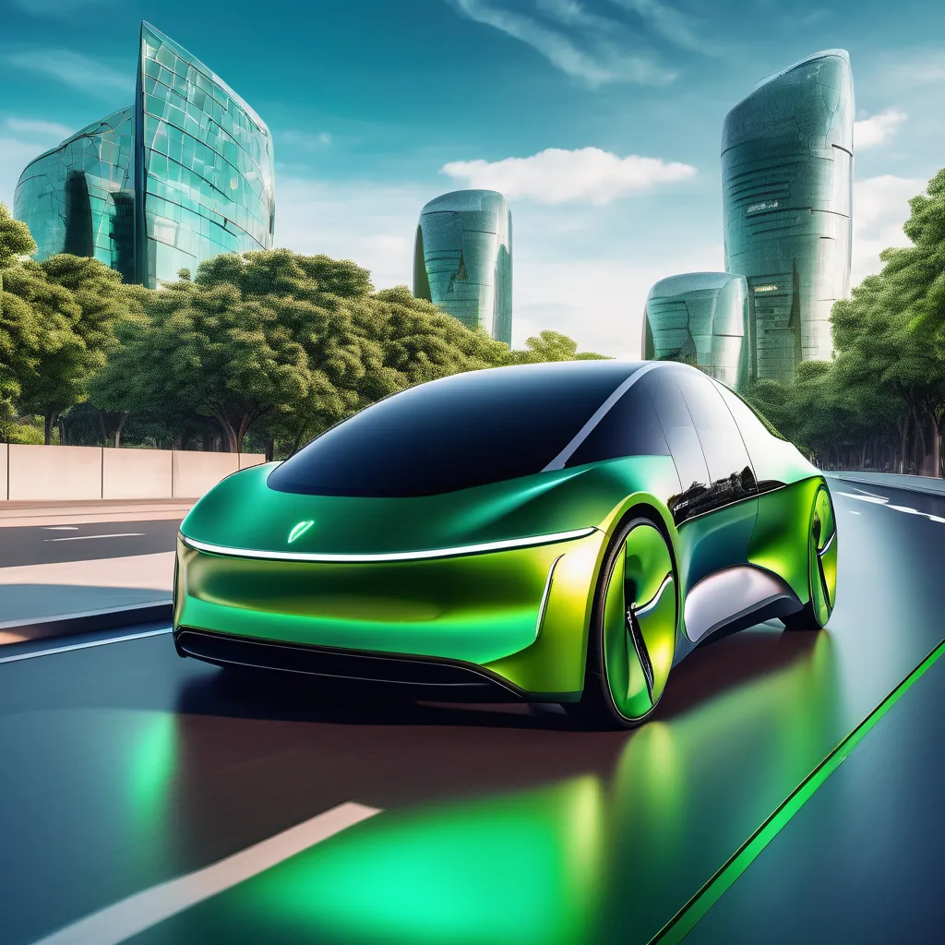
Green Wheels Market Analysis: Steering Bolt to Success in the US EV Market
Data Analysis Report for Bolt US Market Entry in Electrive Automotive

Slide 2
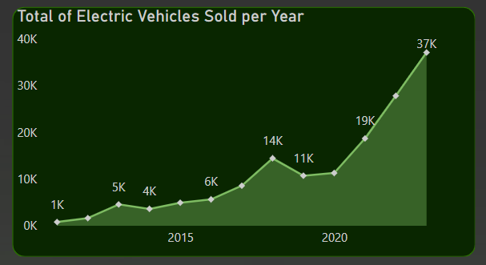
Capitalizing on the EV Revolution
The US EV market is experiencing explosive growth
Consumers are increasingly prioritizing sustainability and embracing electric mobility
This presents a significant opportunity for Bolt, a rising player in the EV market

Slide 3
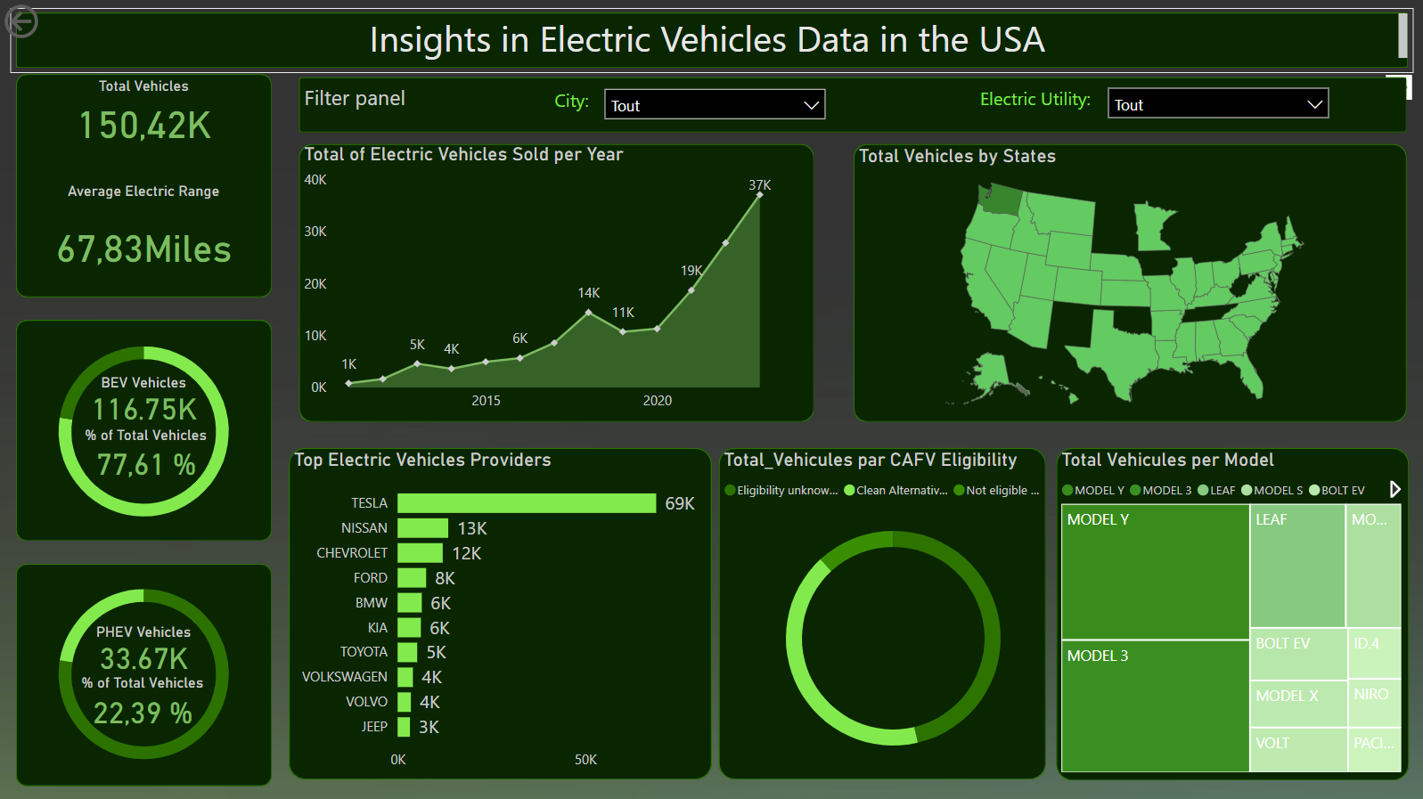
Data-Driven Insights for Strategic Decision Making
Leveraged publicly available data on US EV sales, specifications, and consumer trends
Conducted a comprehensive analysis using Power BI to extract actionable insights
Identified key market trends, consumer preferences, and competitive dynamics

Slide 4
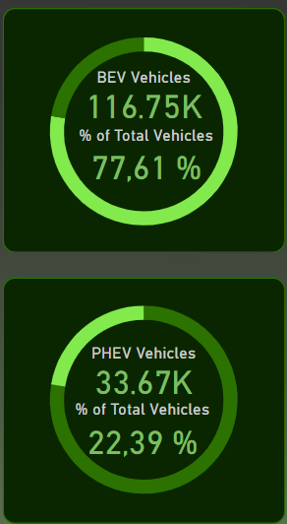
BEVs: Powering Ahead in Consumer Preference
Battery Electric Vehicles (BEVs) represent a larger share of the total EV market compared to Plug-in Hybrid Electric Vehicles (PHEVs)
This suggests a potential shift in consumer preference towards fully electric models

Slide 5
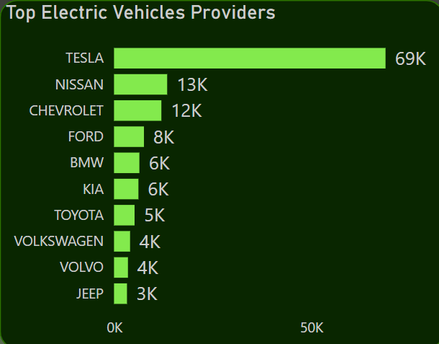
Key Players and Market Dynamics
Tesla holds a dominant position in the US EV market, followed by established automakers like Nissan and Chevrolet
Understanding the competitive landscape is crucial for Bolt to position itself strategically.

Slide 6
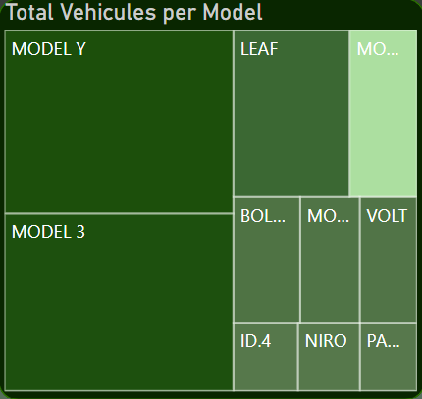
Driving Factors: Range, Affordability, and Brand Appeal
Consumers prioritize EVs with longer electric range, affordability, and strong brand recognition.
Models like Tesla Model 3 and Y, Chevrolet Bolt, and Nissan Leaf are among the most popular choices.

Slide 7

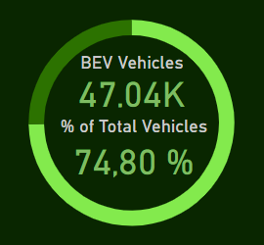
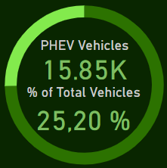
Incentivizing the Shift to Electric
A significant portion of EVs qualify for Clean Alternative Fuel Vehicle (CAFV) incentives.
These incentives play a crucial role in driving EV adoption by enhancing affordability for consumers

Slide 8
Accelerating Bolt's Journey in the EV Revolution
Recommendations:
Focus on BEV Development: Prioritize the development and marketing of competitive BEVs to cater to the growing demand
Competitive Pricing and Features: Offer EVs with compelling features like extended range, advanced technology, and appealing design at competitive price points
Targeted Marketing and Expansion: Concentrate marketing efforts in regions with higher EV adoption rates and explore expansion opportunities in those areas
Strategic Partnerships: Collaborate with charging infrastructure providers to ensure convenient charging solutions for Bolt customers
Leverage Government Incentives: Maximize the benefits of government incentives and effectively communicate their value proposition to potential customers

Slide 9
Positioning Bolt as a Leader in the EV Revolution
By leveraging data-driven insights and implementing these strategic recommendations, Bolt can position itself as a leading player in the rapidly evolving US EV market.
The future of mobility is electric, and Bolt is well-positioned to be at the forefront of this transformative shift.
Bolt: Elevate Your Drive

